Slide 1
Shark tank
Guillermo Bernal

Slide 2
Concepts to develop in this project
Violence
Family
War

Slide 3
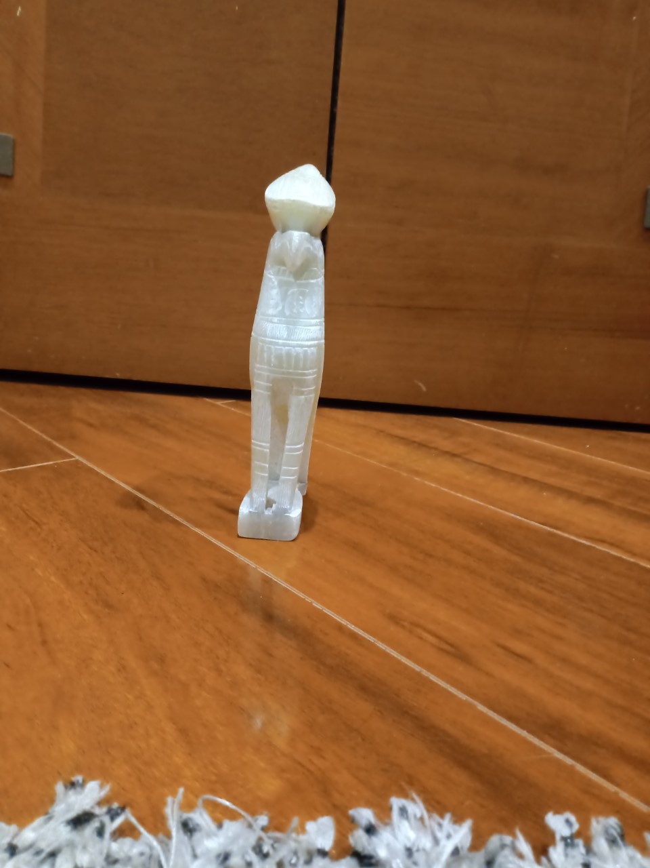
Object
This is a gift of my aunt that she bought it in Pakistan when she was in the USA army, she joined the army when she was young, and leave his family for serving the USA in the middle east.

Slide 4
War, Violence, family
War violence and Family are the 3 basis of my project, my intention of this project is to add up this concepts and get a result where we can see this 3 concepts together and the combination.
War and violence are two concepts that are most of the times together, but when we add up in this concept family the things get complicated and get feelings in the side
One of my objectives is to get this feelings in some drawing that would be an important element of my project

Slide 5
The empty Drawer
The empty drawer is the title of my project, it has 3 main elements, an empty drawer, my object, and the setting, that is composed by drawings and photos,
The empty drawer element is a drawer with some pictures of family inside, it represents all the things that you left behind due to the violence and war of your duty, it represents the memories you have about them, and the rol they play while war and violence

Slide 6
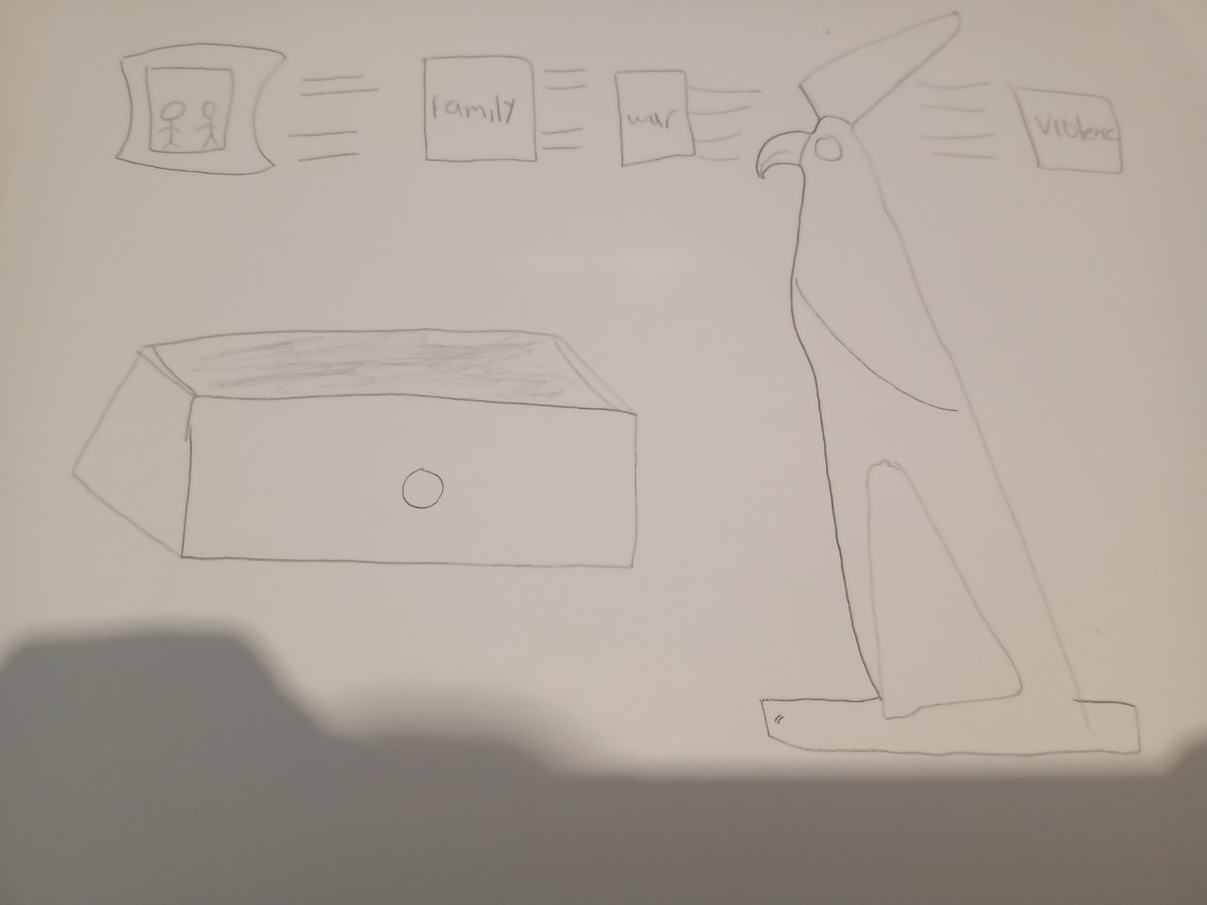
sketch

